Slide 1
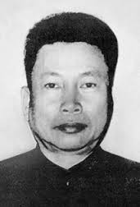
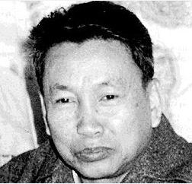
Pol Pot
Saloth Sar

Slide 2
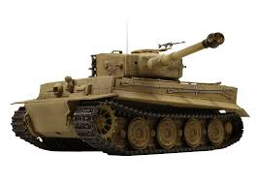
Pol Pot is a nickname his real name is Saloth Sar

Slide 3
Pol Pot was born on the 19th of May in 1925 he was the eighth of nine children

Slide 4
Leadership
Pol pot joined the khmer people's revolutionary party (kprp) and became the prime minister of a Totalitarian Dictatorship
He became the leader of Cambodia on the 17th of April in 1975, when his forces captured Phnom Penh.
From 1976 to 1979, he also served as the prime minister of Democratic Kampuchea

Slide 5
In May 1975, a squad of Khmer Rouge soldiers raided and took Phu Quoc Island. By 1977, relations with Vietnam began to fall apart.

Slide 6
https://www.youtube.com/watch?v=6xATOVv3wSU&feature=youtu.be
Pol implemented socialism by evacuating the main cities to the countryside, getting rid of all money in the system and finally making his party agree to the first ever purge, after he purged Parish who was a top party official and then he purged Cadres. Both of them were of Thai descent.

